Slide 1

DEPARTMENT OF COMPUTER SCIENCE & ENGINEERING
SDM INSTITUTE OF TECHNOLOGY
“MULTIPLE DISEASE PREDICTION”
Under the guidance of
Mr. Pradeep G S
Asst. Professor
Department of CSE
SDMIT, Ujire
Presented By
Punith L
Sannidhi Rai
Susha Jain
Pradnyan Hegde
TEAM ID: 2024CSEPT23

Slide 2
INTRODUCTION
All type of age groups is under diseases so need of early detection of disease by using symptoms or reports is a must.
This project can help a lot of people as one can monitor the person’s condition and take the necessary precautions thus increasing the life expectancy.
To implement multiple disease analysis used machine learning algorithms, Streamlit and python pickling is utilized to save the model behavior.
ML model allows us to build models to get quickly cleaned and processed data and deliver results faster.
We have considered five diseases for now that are Diabetes, Heart Disease, Parkinson’s, Breast Cancer and Liver Disease and in the future, many more diseases can be added.

Slide 3
LITERATURE SURVEY
In the paper "Predictive Analytics for Disease Prevention and Diagnosis" by Bansal et al. (2021) explores the role of machine learning in early detection, diagnosis, and treatment of diseases, using techniques like decision trees and neural networks. It highlights challenges such as data quality, privacy, and interpretability, while emphasizing tools like Scikit-learn and TensorFlow. The study calls for addressing data imbalance and fostering collaboration to advance healthcare systems.

Slide 4
LITERATURE SURVEY
The paper "Multiple Disease Prediction Using Machine Learning Algorithms" by Chauhan et al. (2021) investigates ML techniques like SVM and Decision Trees for predicting diseases such as heart disease and diabetes. It emphasizes predictive analytics for early detection, addressing healthcare challenges like limited infrastructure and low doctor-to-patient ratios. The study integrates predictions into a unified interface, highlighting practical utility in saving lives and improving healthcare decision-making.

Slide 5
LITERATURE SURVEY
The paper "Symptoms Based Multiple Disease Prediction Model Using Machine Learning Approach" by Kolli et al. (2021) explores ML techniques like decision trees, SVM, and KNN for predicting multiple diseases using symptoms. It emphasizes the role of feature selection, preprocessing, and user-friendly interfaces in enhancing accuracy and accessibility. The study highlights challenges like data quality, overlapping symptoms, and scalability, while calling for improvements in data integration, model interpretability, and real-time deployment to make ML-based systems more practical in healthcare.

Slide 6
LITERATURE SURVEY
The paper "A Comparative Study of Machine Learning Algorithms for Disease Prediction" by Gupta et al. (2021) [4] evaluates ML algorithms like SVM, Decision Trees, Random Forest, Logistic Regression, and KNN for predicting diseases. It highlights their performance in terms of accuracy, efficiency, and scalability, emphasizing the importance of dataset-specific algorithm selection. The study recommends ensemble and hybrid models to address challenges like overfitting and imbalanced datasets, advocating for explainable ML solutions and further optimization for real-world healthcare applications.

Slide 7
LITERATURE SURVEY
The paper "Predictive Analytics for Disease Prevention and Diagnosis: A Machine Learning Approach" by Bansal et al. (2021) [5] explores ML's role in early detection, diagnosis, and treatment of diseases using techniques like decision trees, SVMs, and neural networks. It addresses challenges like data quality, privacy, and ethical concerns while highlighting tools such as Scikit-learn and TensorFlow. The study emphasizes tackling data imbalance and fostering collaboration to create robust, user-friendly healthcare solutions.

Slide 8
PROBLEM STATEMENT
Single-Disease Focus: Most machine learning models are designed for analyzing only one disease at a time (e.g., liver disease, cancer, lung disease).
Multiple Platforms: Users must visit different websites or platforms to predict various diseases, leading to a fragmented experience.
No Unified Solution: There's a lack of a single system that can predict multiple diseases simultaneously.

Slide 9
OBJECTIVES
Provide a seamless experience for users to predict a variety of diseases in one place.
1. Early Detection: Develop machine learning models to accurately predict the onset of heart disease, diabetes, and Parkinson's, enabling timely intervention.
2. User-Friendly Tool: Provide a seamless experience for users to predict a variety of diseases in one place

Slide 10
3. Resource Accessibility: Focus on making the diagnostic solution available in resource-limited areas to improve healthcare access for underserved populations.
4. Impact Assessment: Evaluate the effectiveness of the predictive models in real-world settings to measure improvements in patient outcomes and overall public health.

Slide 11
HARDWARE AND SOFTWARE REQUIREMETS
Hardware Requirements:
Sl. No | Hardware/Equipment | Specification
1. | Graphics Card | Intel 621 Graphics card or 2GB
2. | RAM | 4GB or above

Slide 12
Software Requirements
Sl. No | Software | Specification
1. | Anaconda | Anaconda 64 bit
2. | spyder | Version 5.4.3
3. | Framework | Streamlit
4. | Google collab | Cloud based python notebook
5. | Scikit-learn | Version 1.3.0

Slide 13
METHODOLOGY
The proposed multiple disease prediction system is implemented using the following steps:
Data collection: Gather data related to patients, such as demographic information (age, gender), medical history, clinical test results (blood pressure, cholesterol) and genetic data.
Data pre-processing: Then the next step is data pre-processing. It is the process of converting raw data into a clean data. In this process missing values, noisy and inconsistent data in the dataset are handled.

Slide 14
Train Test split: Here data is split for training and testing purpose. 70% of the data is used to train the model and remaining 30% of the data is used for testing. Then dataset will be trained using Support Vector Machine classifies and Logistic Regression.
Modelling: After the training and testing of the models, confusion matrix is plotted, and accuracy score is computed for each algorithm. Then based on the accuracy score best suited algorithm for the prediction of disease is identified.

Slide 15
APPLICATIONS
1. Doctor’s Tool: Help doctors identify health risks early and make better treatment decisions.
2. Health Screenings: Use the tool in community health events to find at-risk individuals.
3. Remote Care: Provide online consultations for patients in distant areas, improving access to healthcare.

Slide 16
4. Patient Awareness: Educate patients about their health risks to encourage healthier lifestyle choices.
5. Research Support: Analyze data to improve understanding of diseases and enhance predictive models.

Slide 17
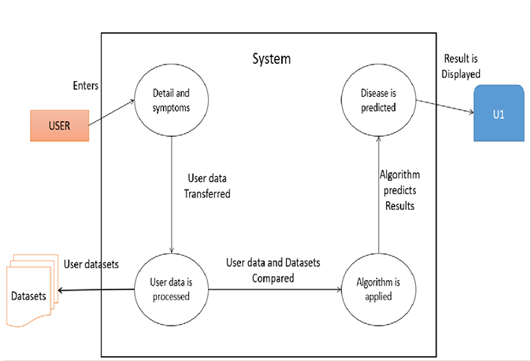
SYSTEM DESIGN
System Architecture

Slide 18
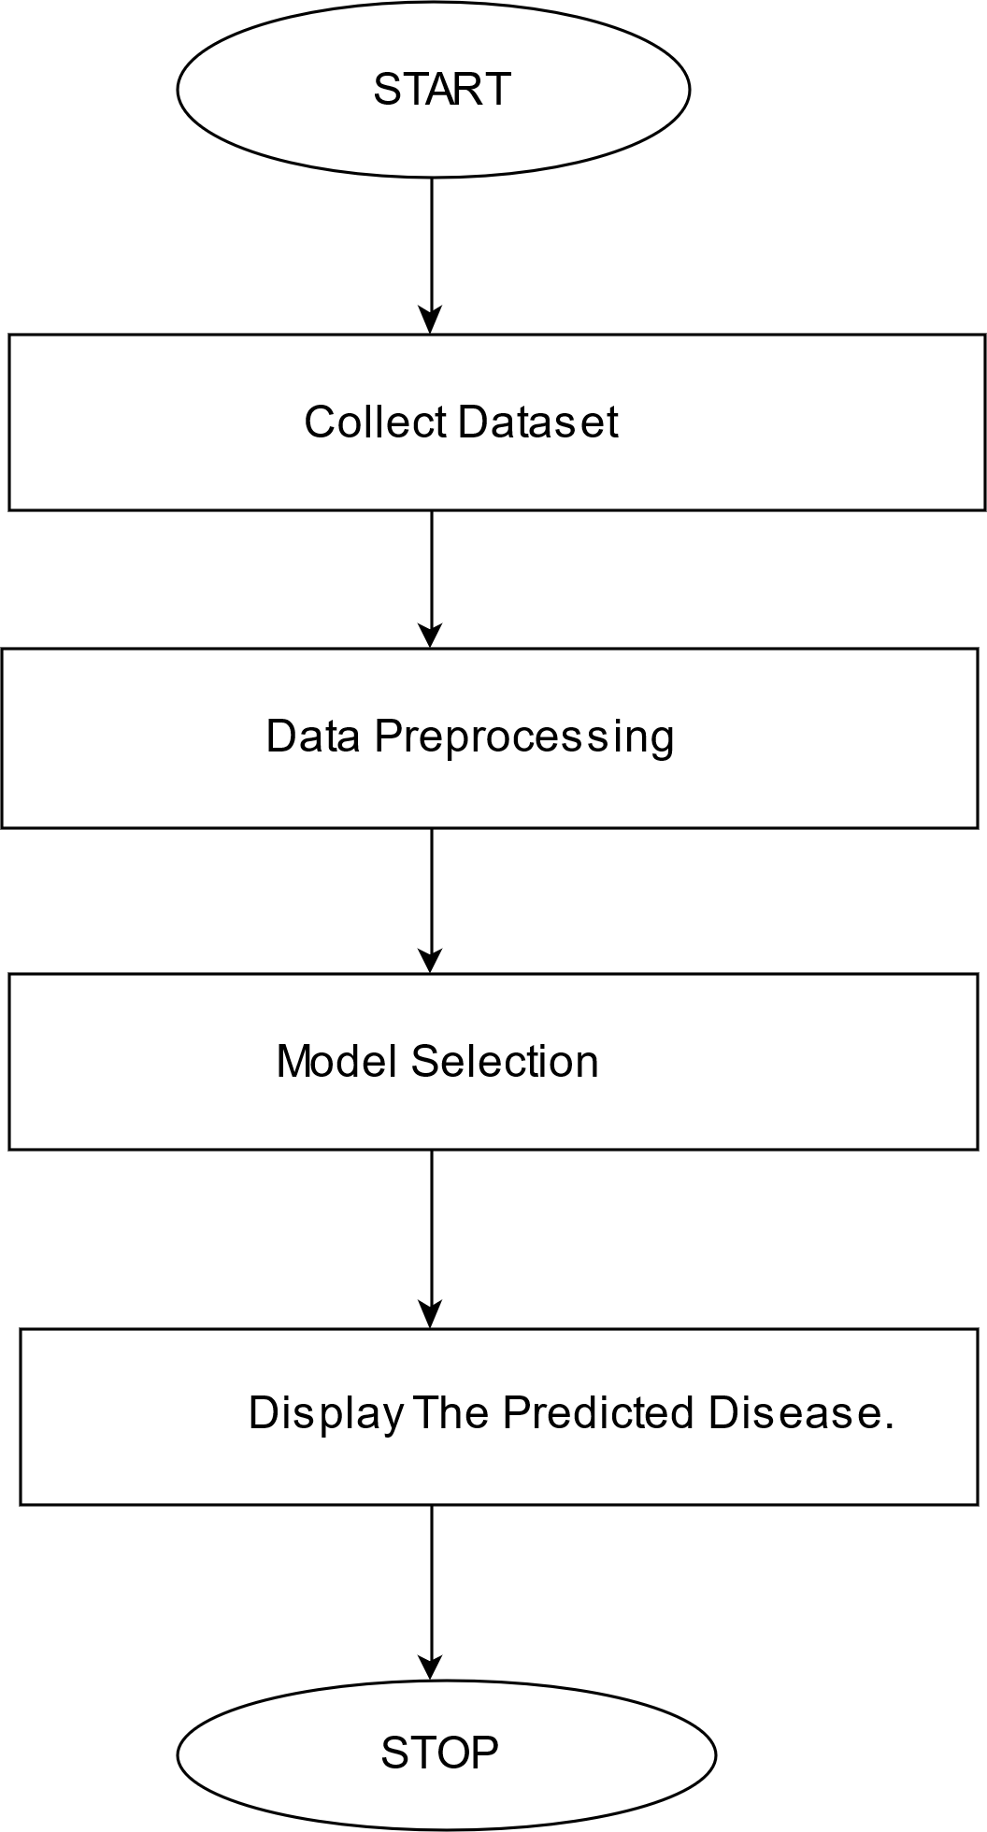
System Flowchart

Slide 19
ALGORITHMS
In our multiple disease prediction project, we utilized Support Vector Machines (SVM), Logistic Regression model and Random Forest to achieve accurate and reliable results.
SVM is a robust classification algorithm that works by finding the optimal hyperplane that separates data points into distinct classes.
It is particularly effective in handling high-dimensional datasets and ensures maximum margin separation, which makes it suitable for complex medical data with multiple features.

Slide 20
Logistic Regression, on the other hand, is a widely-used statistical model for binary and multi-class classification. It predicts the probability of an outcome using a sigmoid function and is highly interpretable, making it ideal for understanding relationships between predictors and disease outcomes.
Together, these algorithms provided a comprehensive approach for predicting diseases, leveraging the strengths of SVM in handling non-linear relationships and Logistic Regression for its simplicity and interpretability in binary classification scenarios.

Slide 21
Random Forest is an ensemble learning algorithm that builds multiple decision trees during training and merges their outputs (via majority voting for classification or averaging for regression) to enhance predictive accuracy and reduce overfitting. It operates by randomly selecting subsets of data and features for each tree, making it robust against noise and adaptable to both classification and regression tasks. This method is highly effective in handling large datasets and complex relationships while maintaining good generalization capabilities.

Slide 22
DATASETS
The datasets were sourced from Kaggle and are well-suited for training models such as SVM, Logistic Regression and Random Forest.

Slide 23
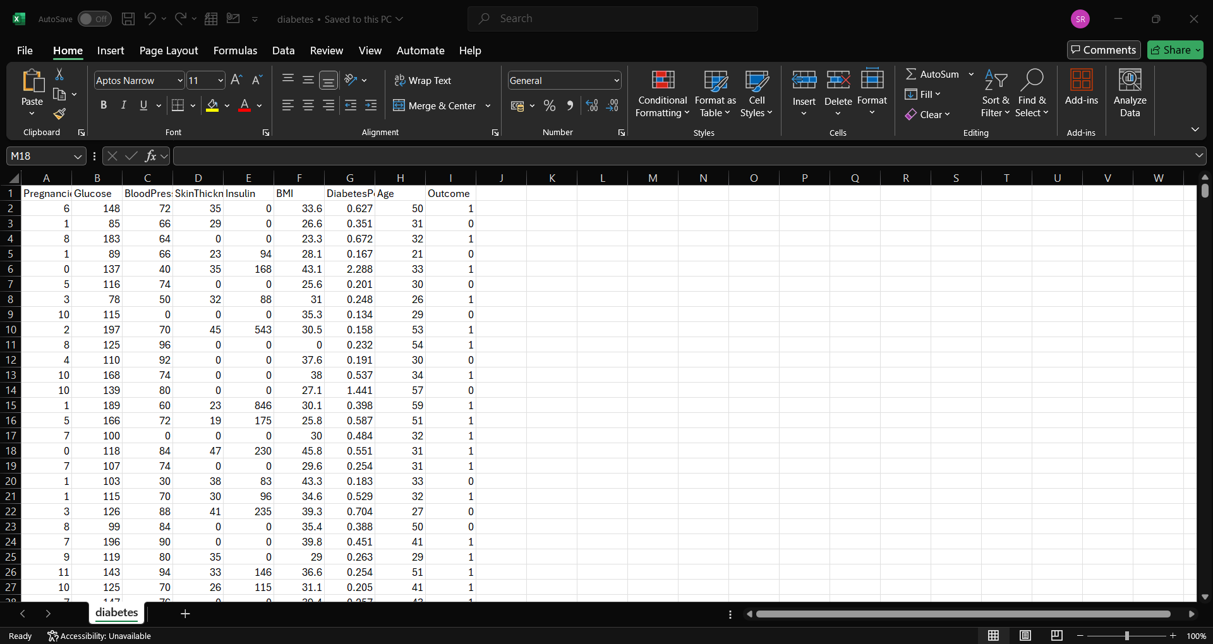
Diabetes Dataset(768)

Slide 24
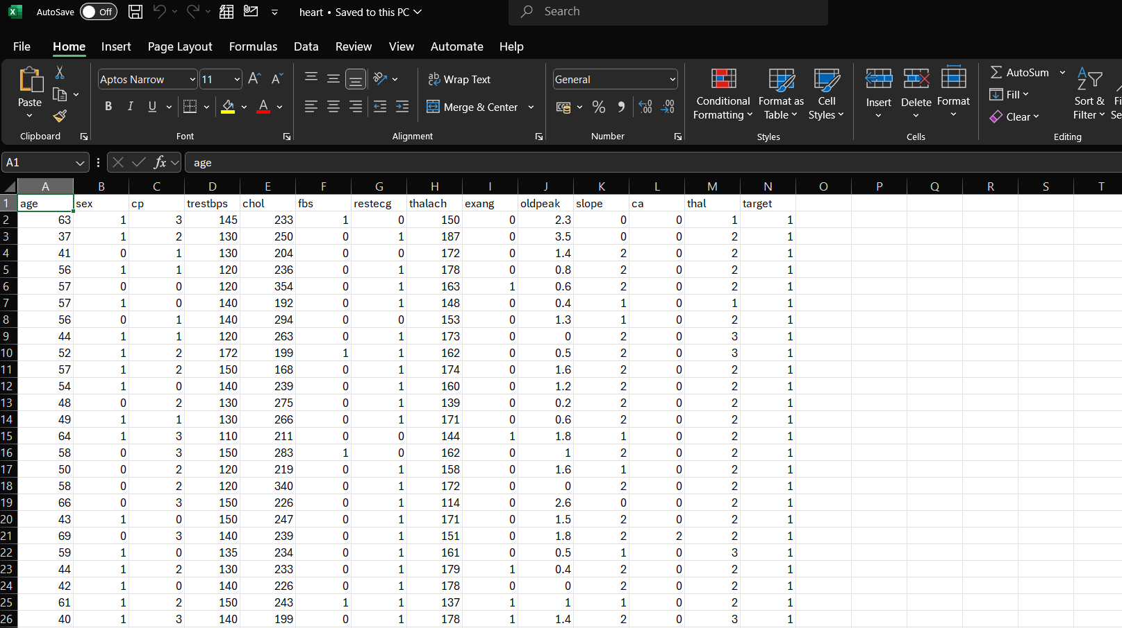
Heart Disease dataset(303)

Slide 25
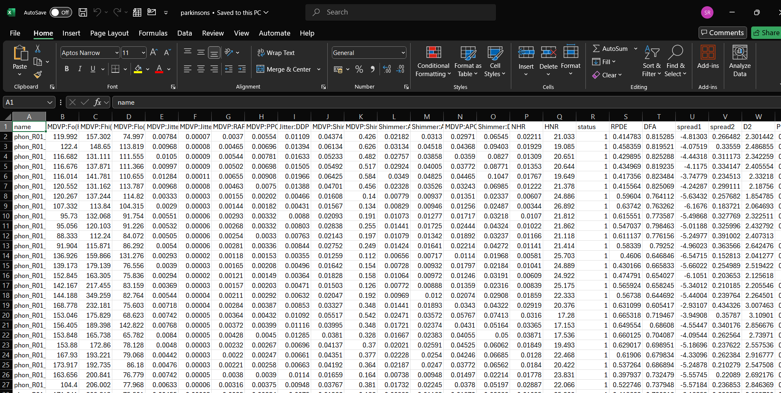
Parkinson’s Dataset(195)

Slide 26
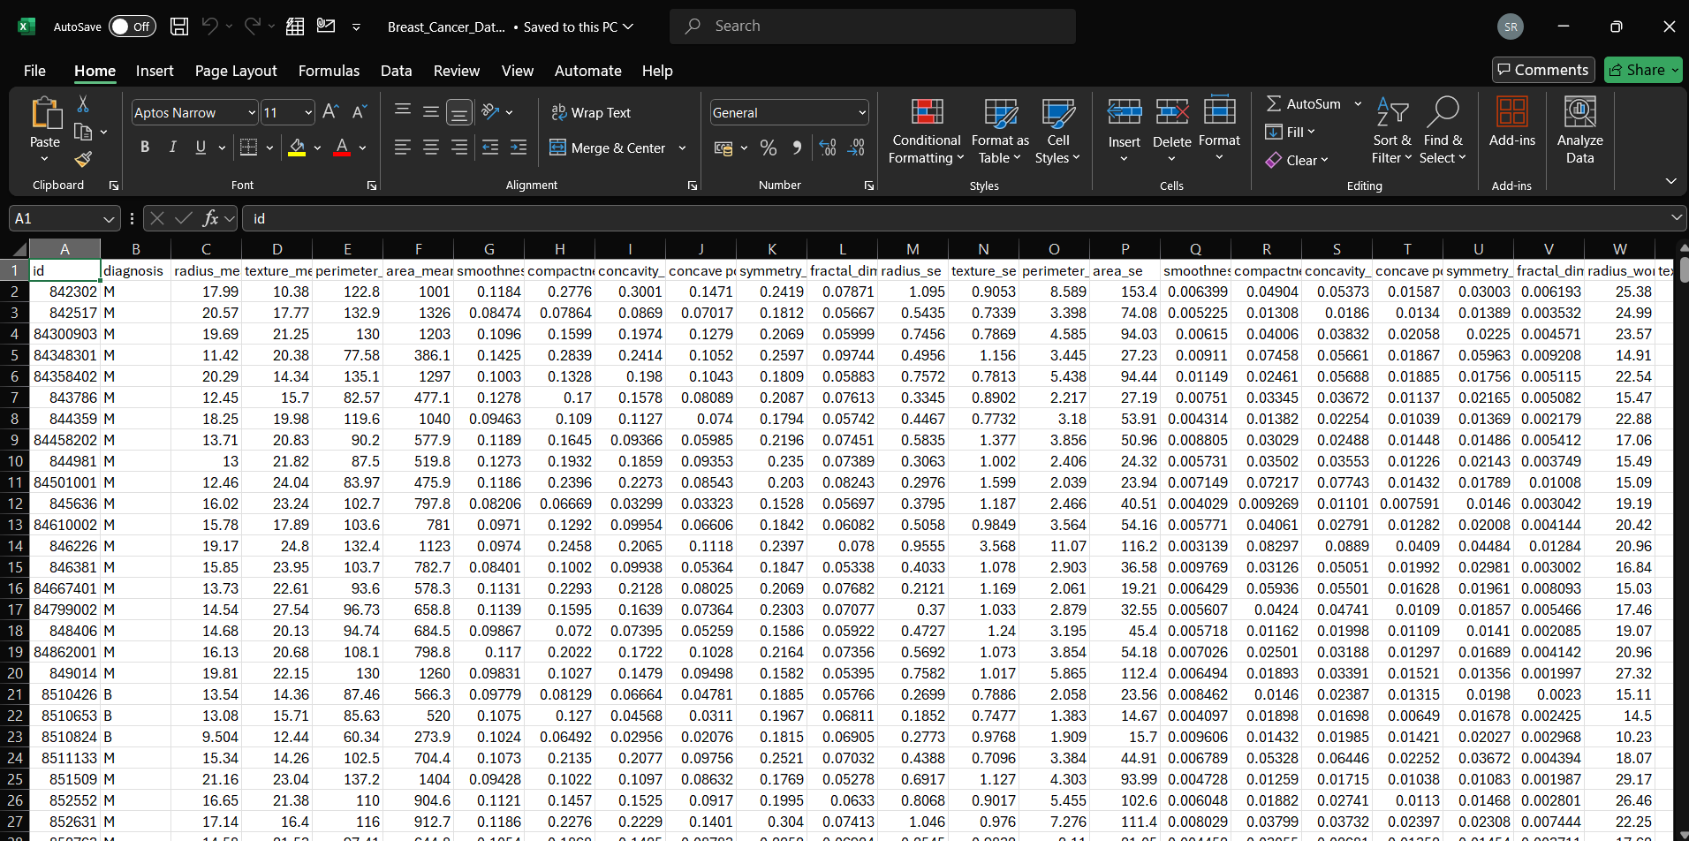
Breast Cancer Dataset(569)

Slide 27
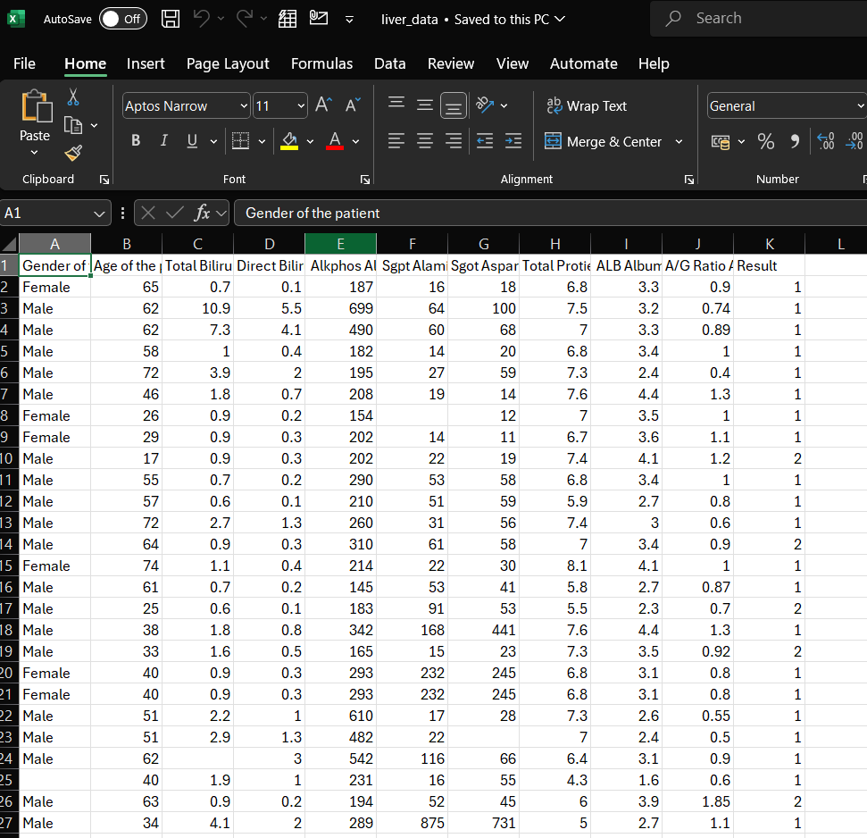
Liver Disease Dataset(30691)

Slide 28
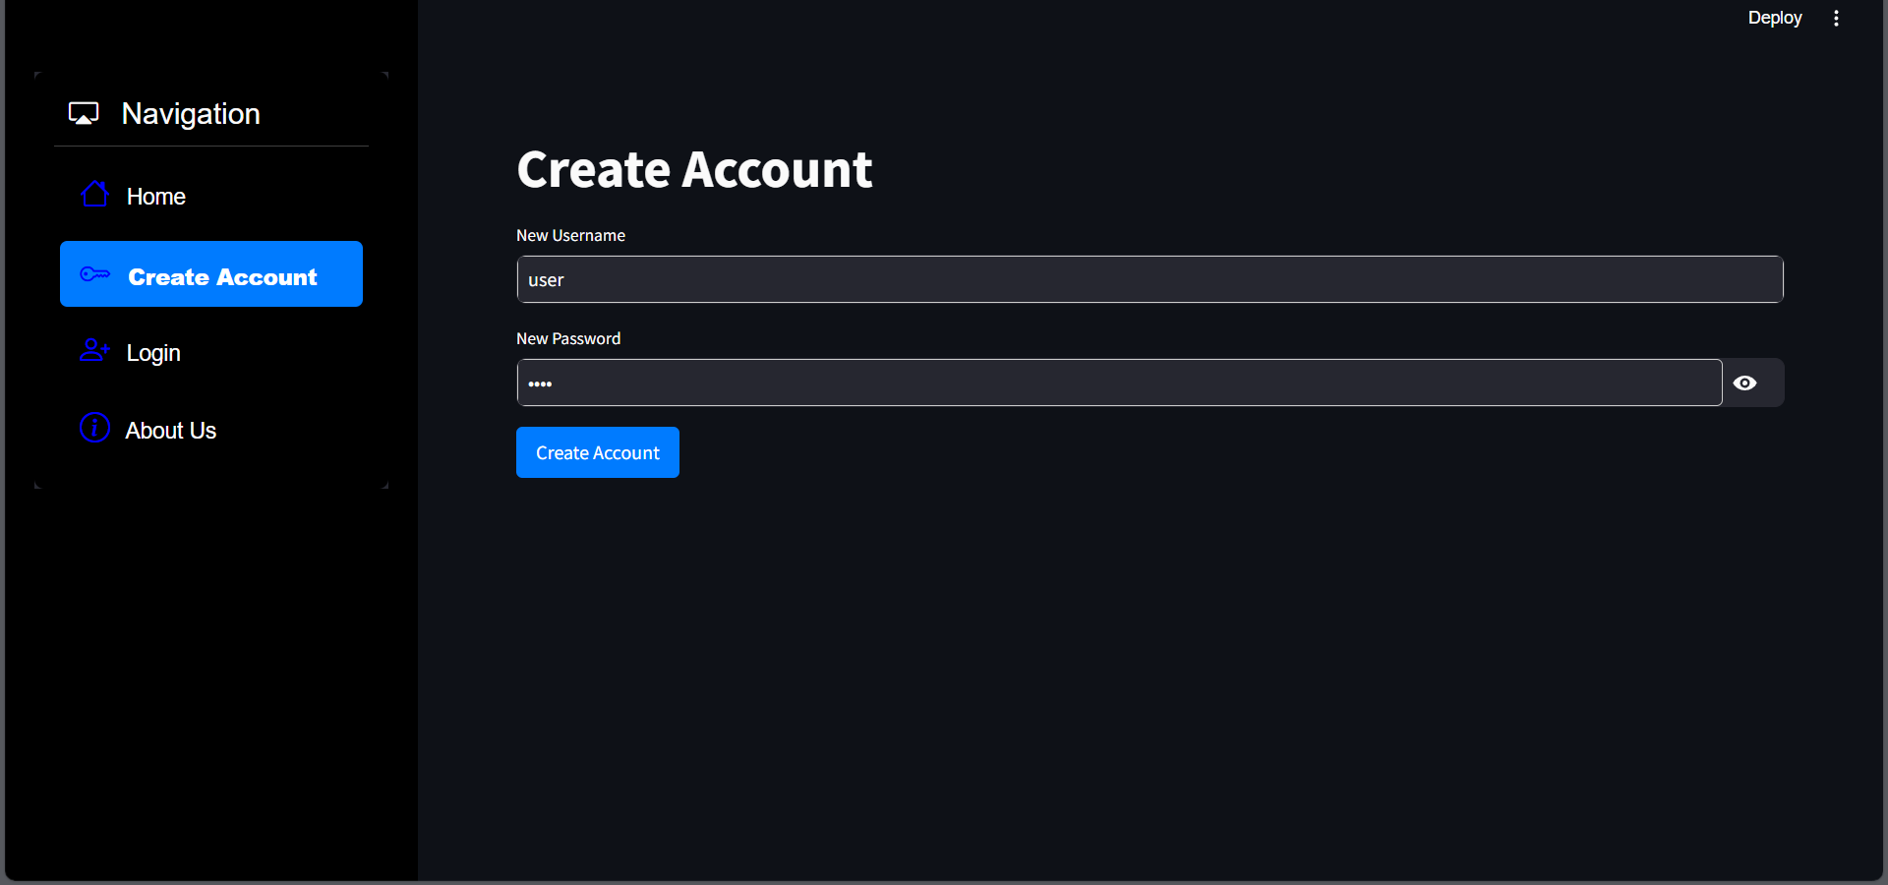
IMPLEMENTATION
Create an account for the user

Slide 29
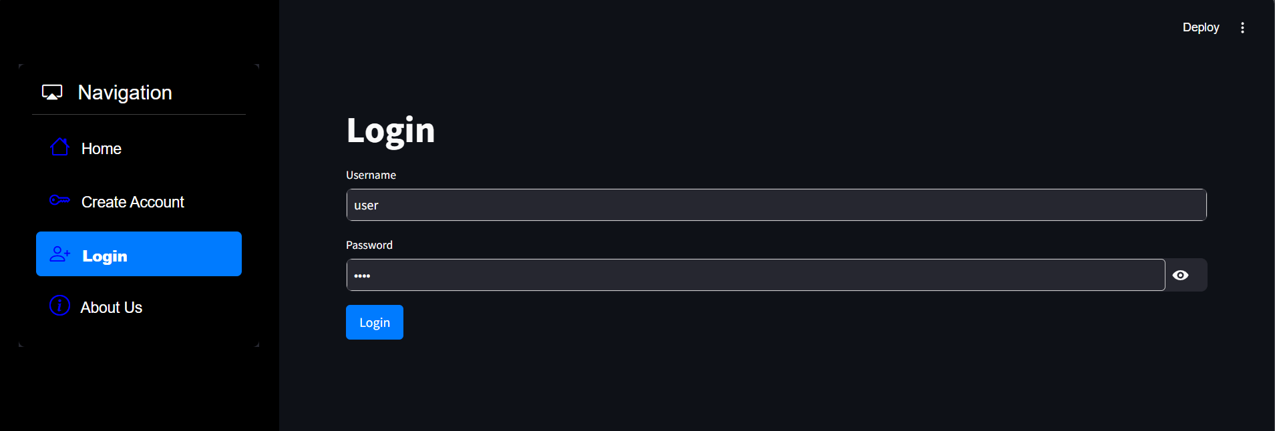
Login page

Slide 30
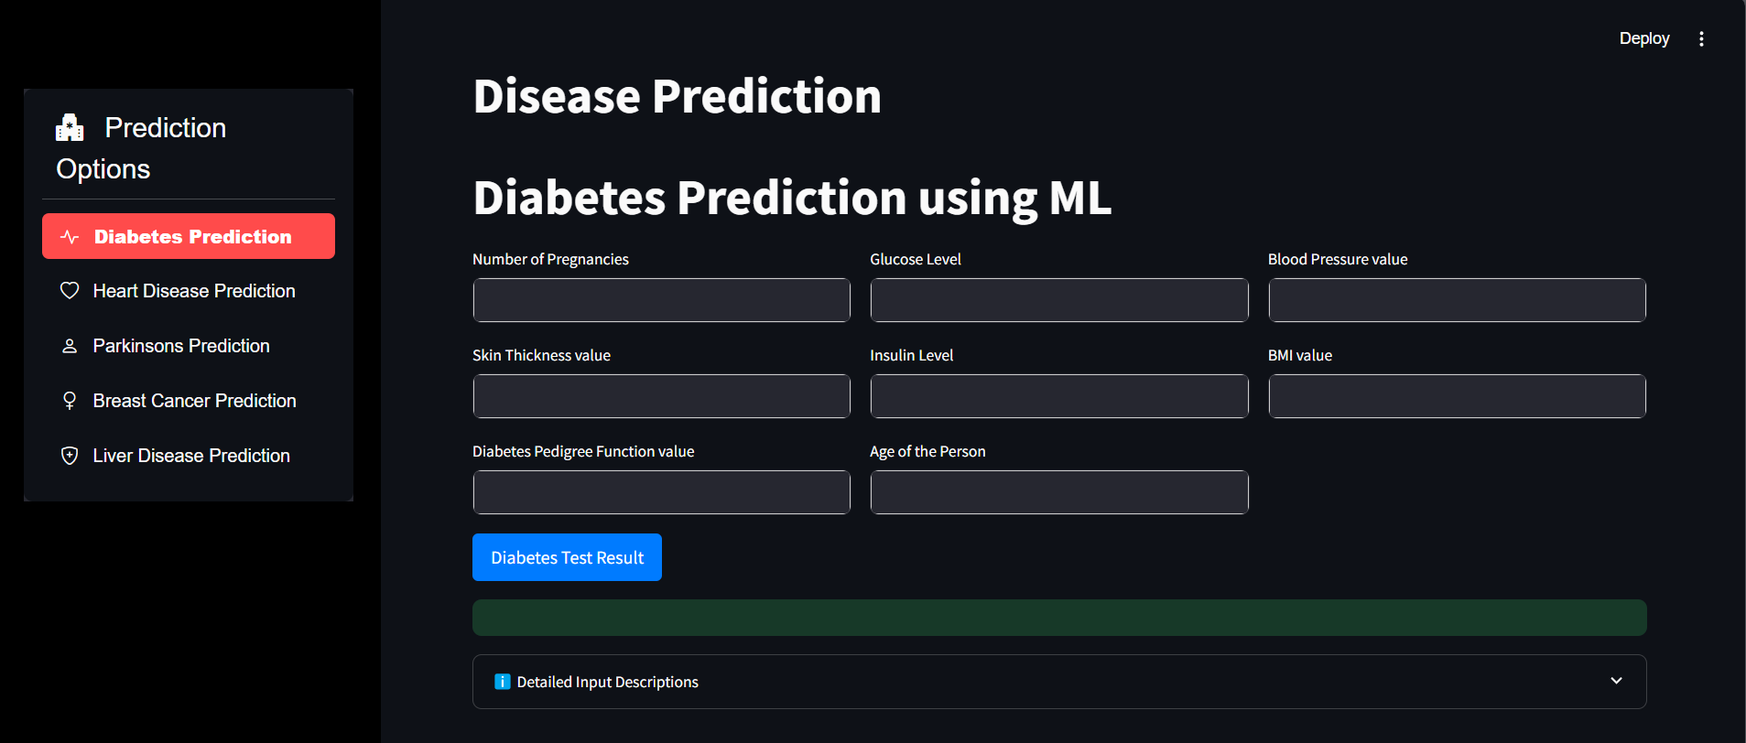
Diabetes prediction page

Slide 31
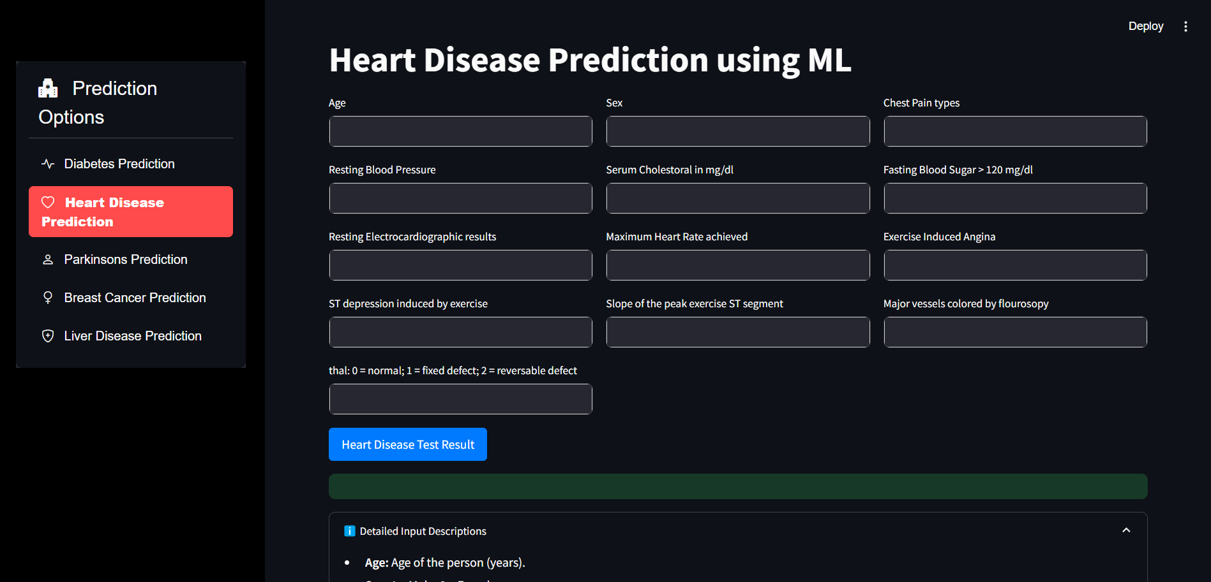
Heart Disease prediction page

Slide 32
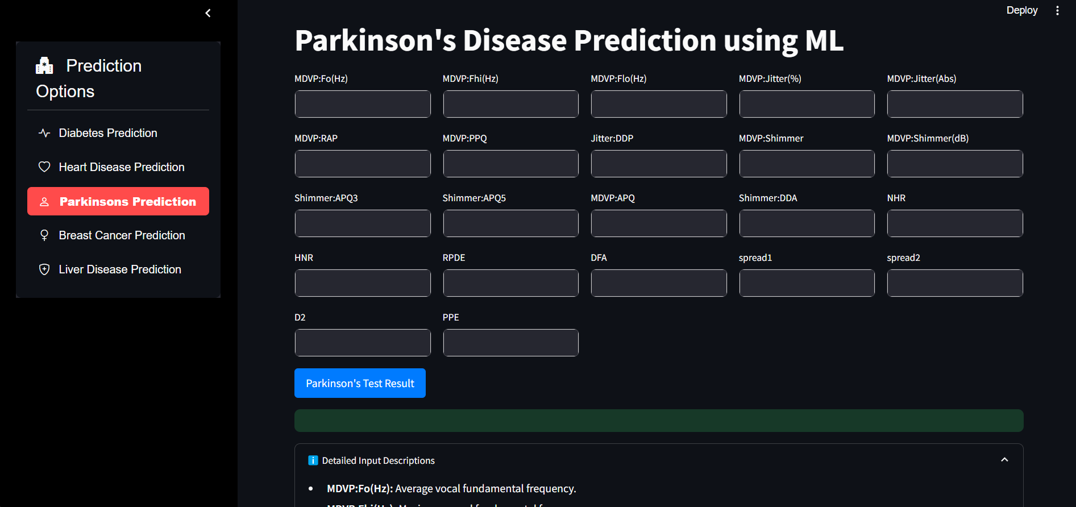
Parkinson’s prediction page

Slide 33
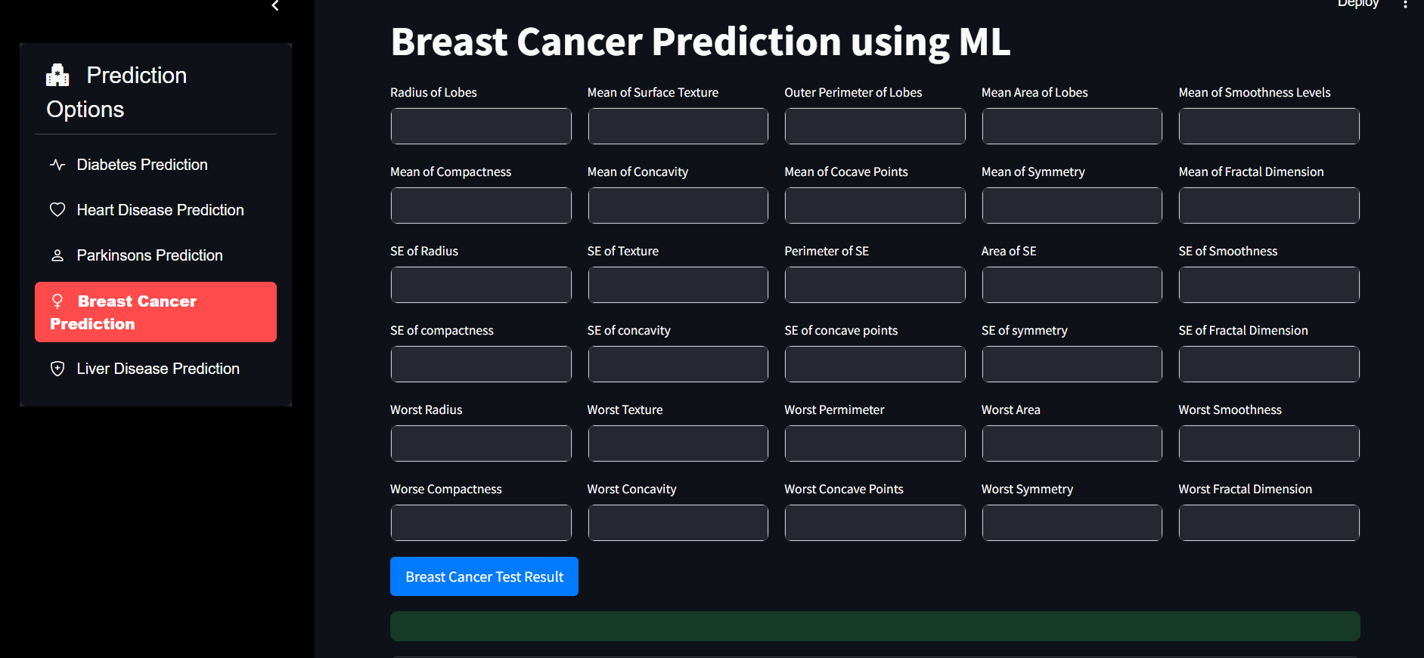
Breast Cancer prediction page

Slide 34
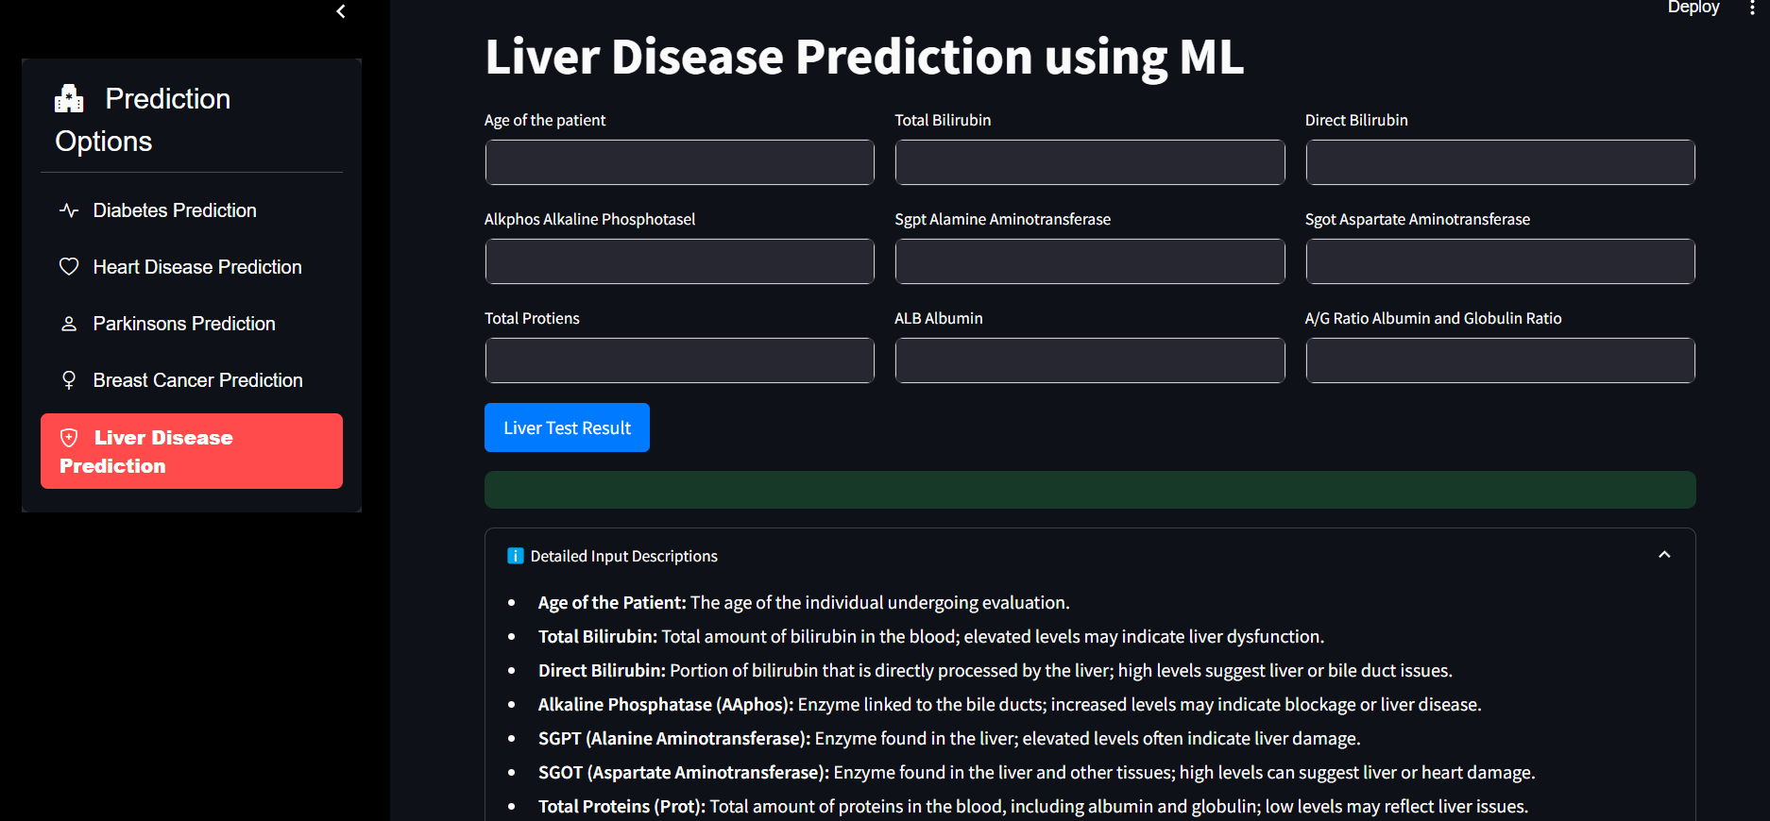
Liver Disease prediction page

Slide 35
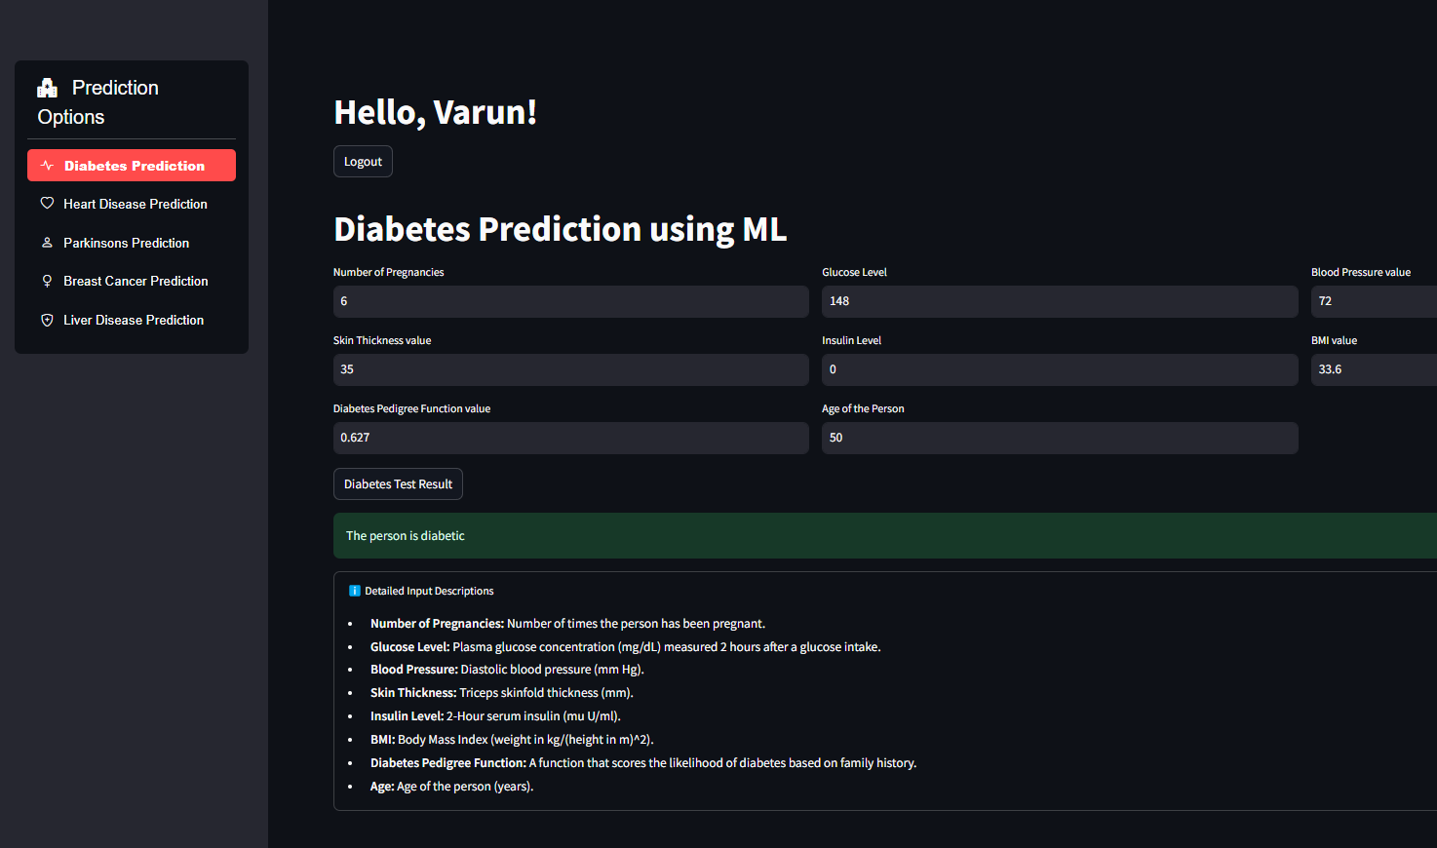
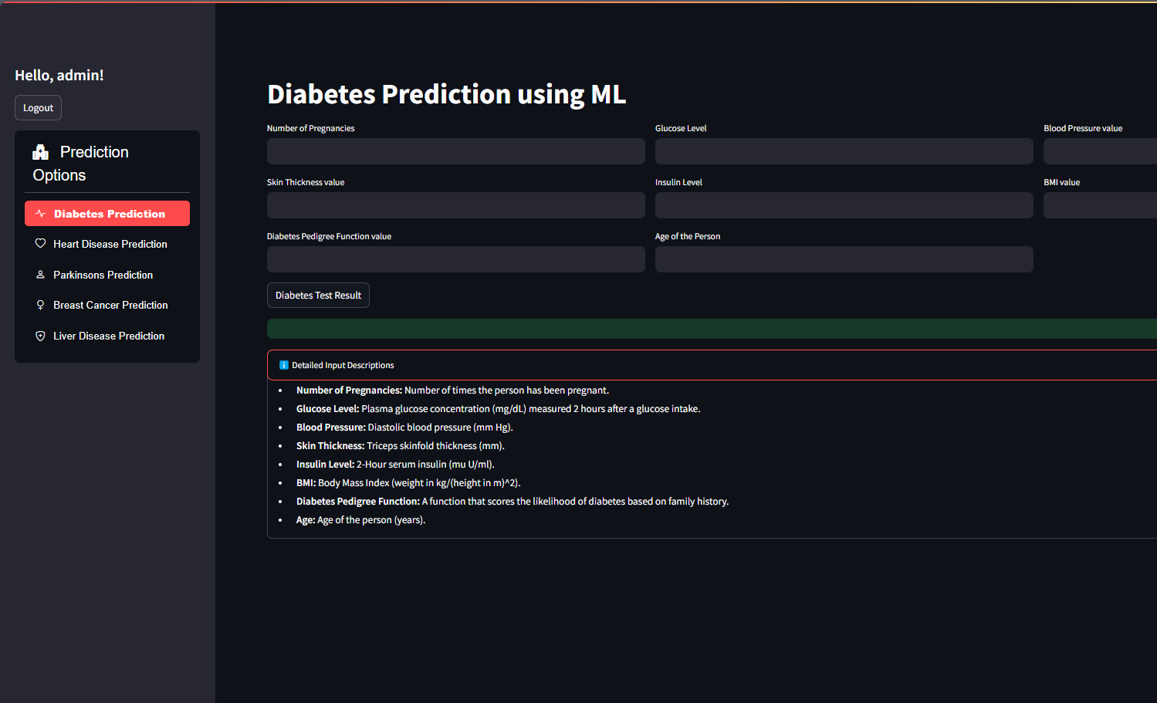
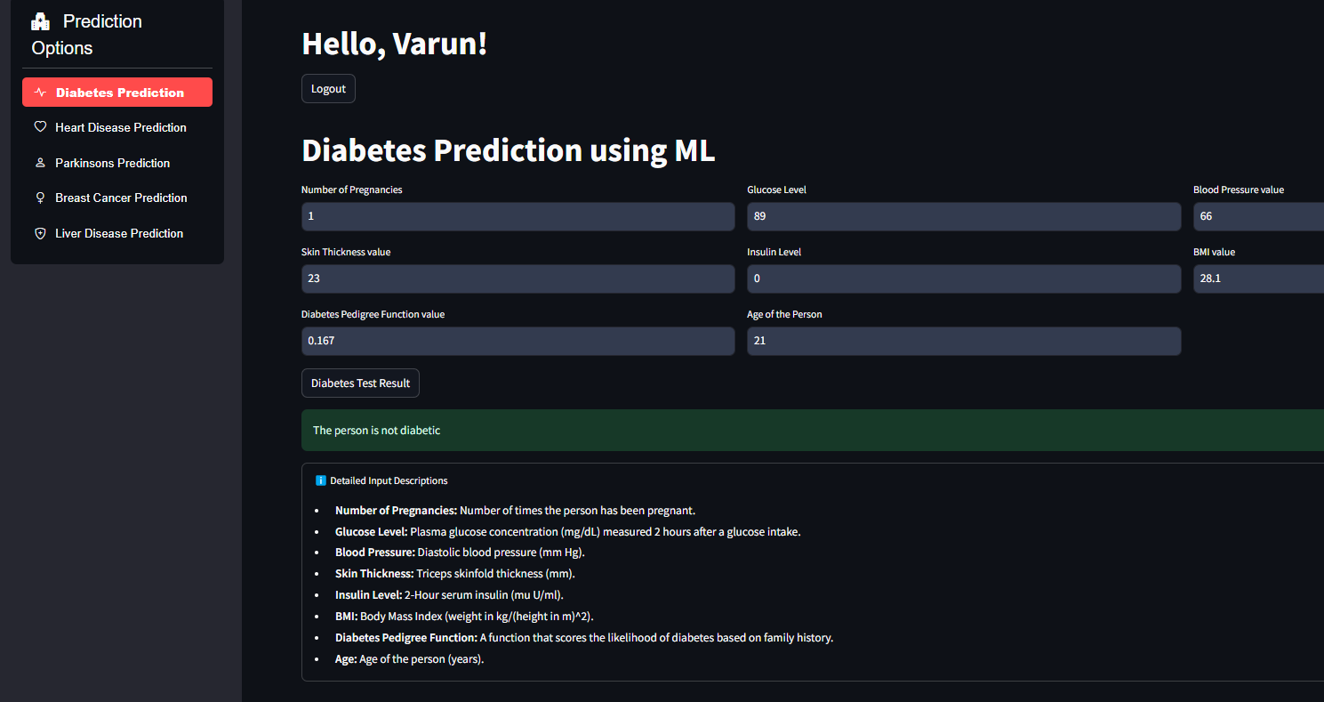
SYSTEM TESTING
Test Case Number | Input | Stage | Expected behaviour | Observed behaviour | Status P = Pass F= Fail
1 | Insert all the values to the displayed parameters in diabetes prediction Page (person is diabetic) | Preview page | Should display result as The person is diabetic | The person is diabetic | P
2 | Insert all the values to the displayed parameters in diabetes prediction Page (person is not diabetic) | Preview page | Should display result as The person is not diabetic | The person is not diabetic | P

Slide 36
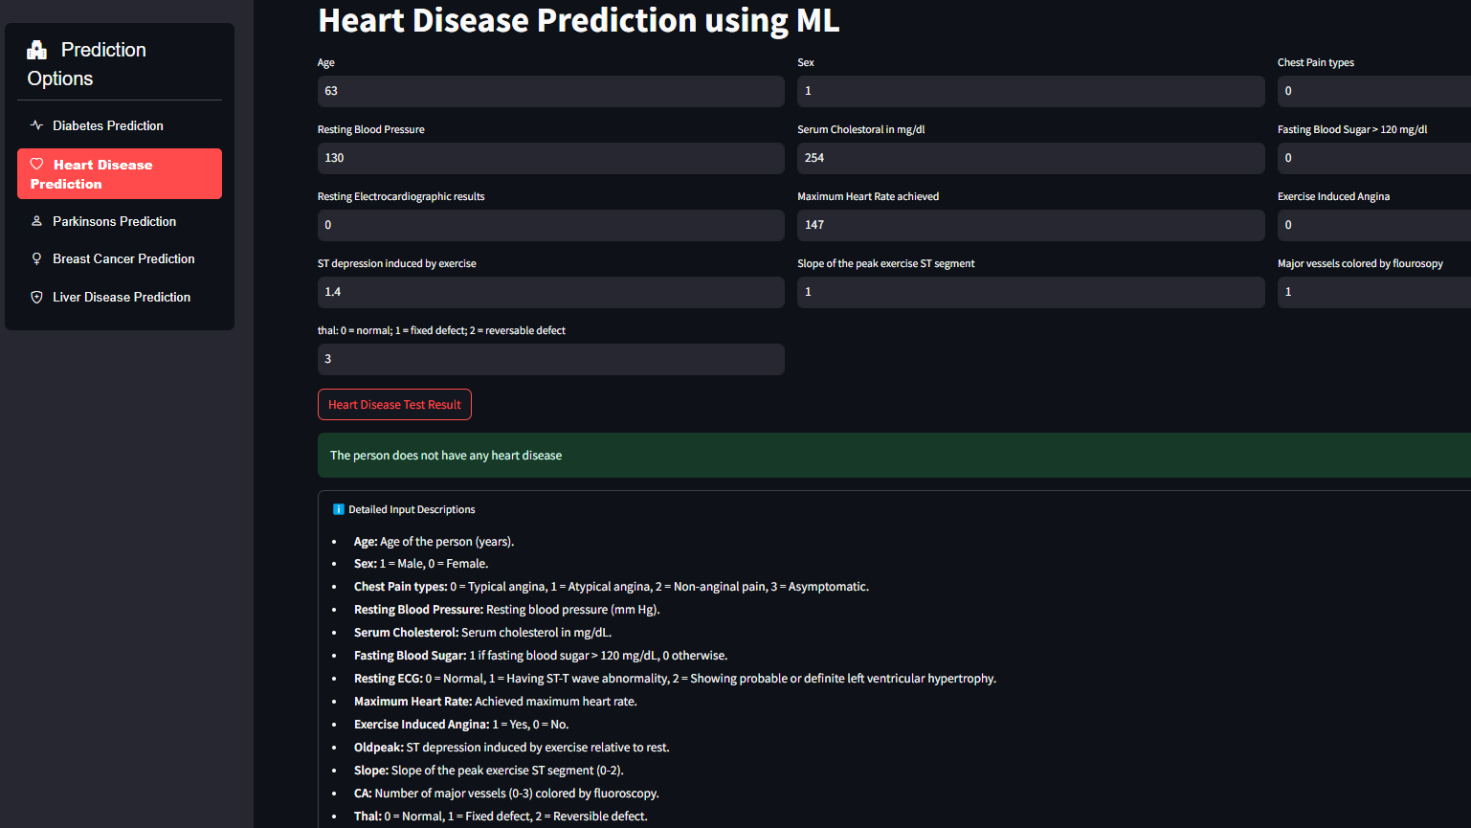
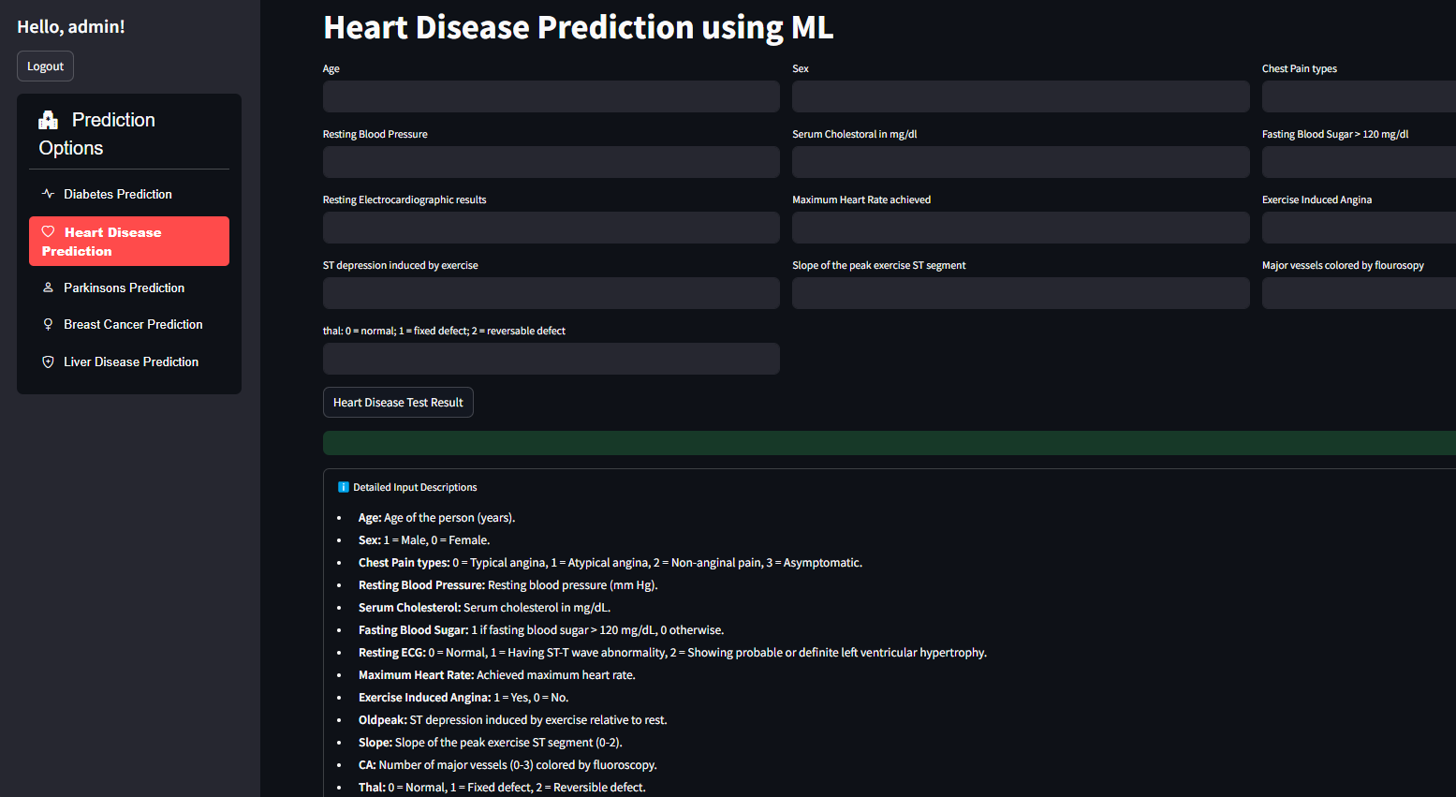
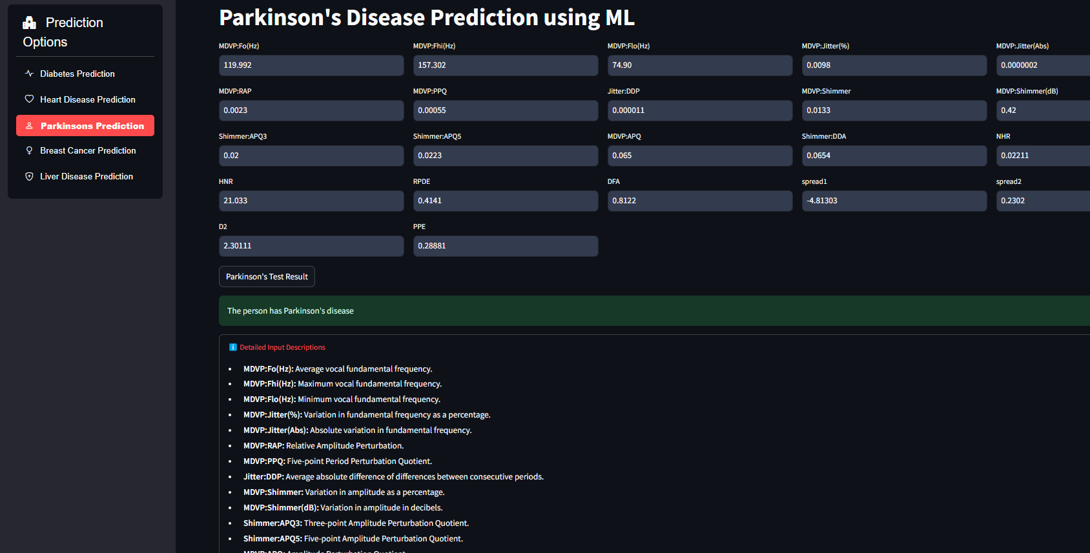
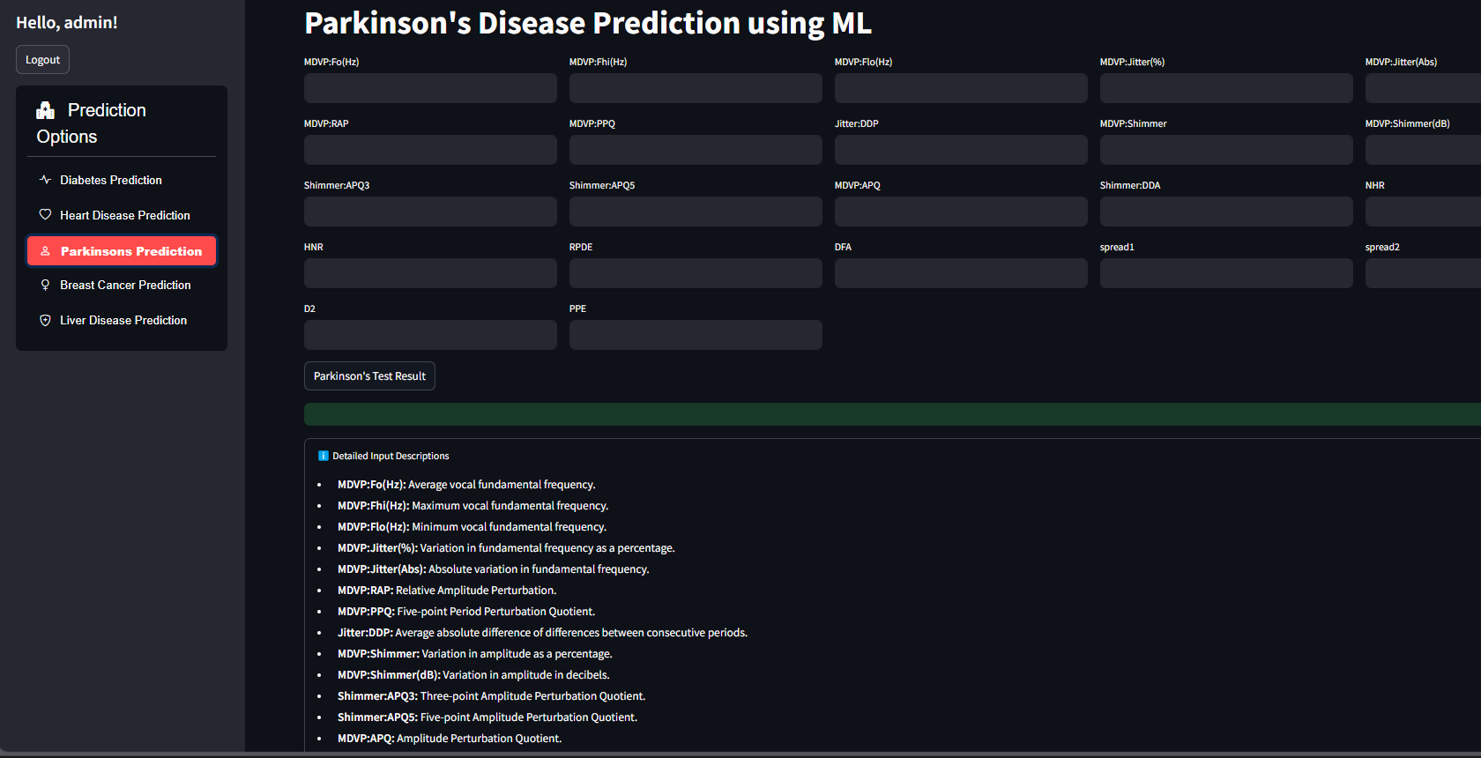
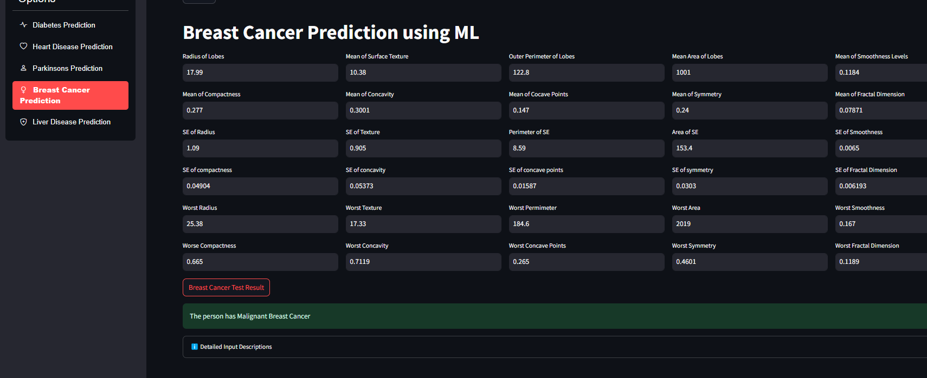
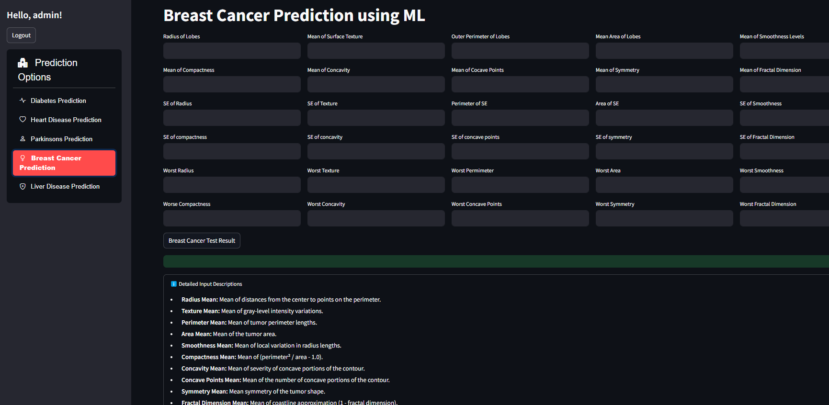
3 | Insert all the values to the displayed parameters heart disease prediction Page (person does not have a heart disease) | Preview page | Should display result as The person does not have heart disease | The person does not have heart disease | P
4 | Insert all the values to the displayed parameters in Parkinson’s prediction Page (person has Parkinson’s) | Preview page | Should display result as The person has Parkinson’ s | The person has Parkinson’s | P
5 | Insert all the values to the displayed parameters in Breast Cancer prediction Page (person has Breast Cancer) | Preview page | Should display result as The person has Breast Cancer | The person has Breast Cancer | P

Slide 37
Result Analysis
Training Size | Testing Size | Accuracy (%)
 |  | SVM | LR | RF
80% | 20% | 77.27 | 75.32 | 75.32
Training Size | Testing Size | Accuracy (%)
 |  | SVM | LR | RF
80% | 20% | 81.96 | 81.96 | 77.05

Slide 38
Training Size | Testing Size | Accuracy (%)
 |  | SVM | LR | RF
80% | 20% | 87.179 | 87.18 | 84.61
Training Size | Testing Size | Accuracy (%)
 |  | SVM | LR | RF
80% | 20% | NA | 71.87 | 99.65

Slide 39
Training Size | Testing Size | Accuracy (%)
 |  | SVM | LR | RF
80% | 20% | NA | 71.87 | 99.65

Slide 45
CONCLUSION & SCOPE FOR FUTURE WORK
In the future we can add more diseases in the existing API.
We can try to improve the accuracy of prediction in order to decrease the mortality rate
Try to make the system user-friendly and provide a chatbot for normal queries

Slide 46
REFERENCES
V. Sharma, et al., "Multimodal Machine Learning Approaches for Disease Prediction: A Survey," 2022.
C. Chauhan, et al., "Multiple Disease Prediction Using Machine Learning Algorithms," 2021.
S. Kolli, et al., "Symptoms Based Multiple Disease Prediction Model Using Machine Learning Approach," 2021.
A. Gupta, et al., "A Comparative Study of Machine Learning Algorithms for Disease Prediction," 2021.
Bansal, et al., "Predictive Analytics for Disease Prevention and Diagnosis: A Machine Learning Approach," 2021.

Slide 47
Thank You

